Slide 1
Stealing the Future - COMP3851A
A platformer metroidvania by:
Toby Tumsithi, Garth Vassel, Lakshya, Kiranjot Kaur
Notes:
Toby

Slide 2
Overview
Background
Inspiration
Requirements
Ethics
Our project
Features
Marketing
Art
Sound
Demonstration
Challenges and Limitations
Future plans
Conclusions
Notes:
Toby

Slide 3
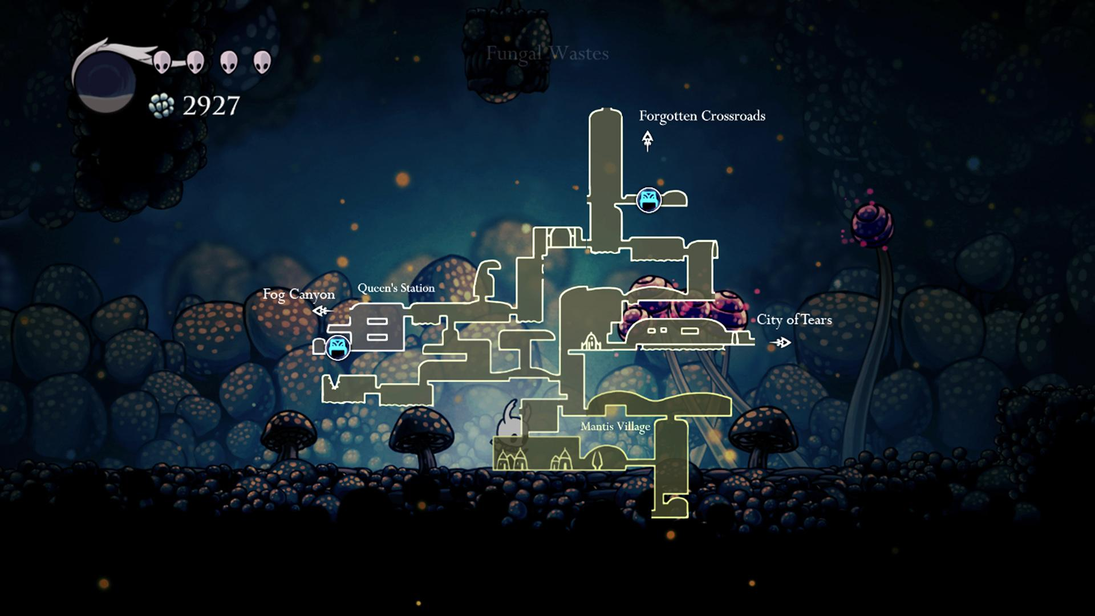
Background
Large interconnected map
Items and abilities to find
Secrets
Puzzles
Figure 1
Notes:
Toby

Slide 4
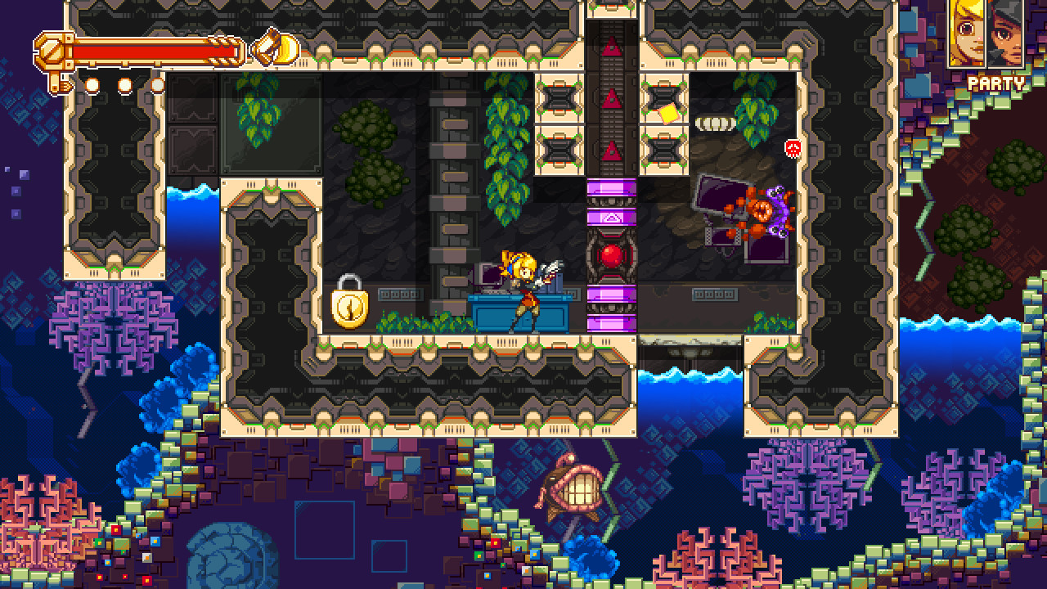
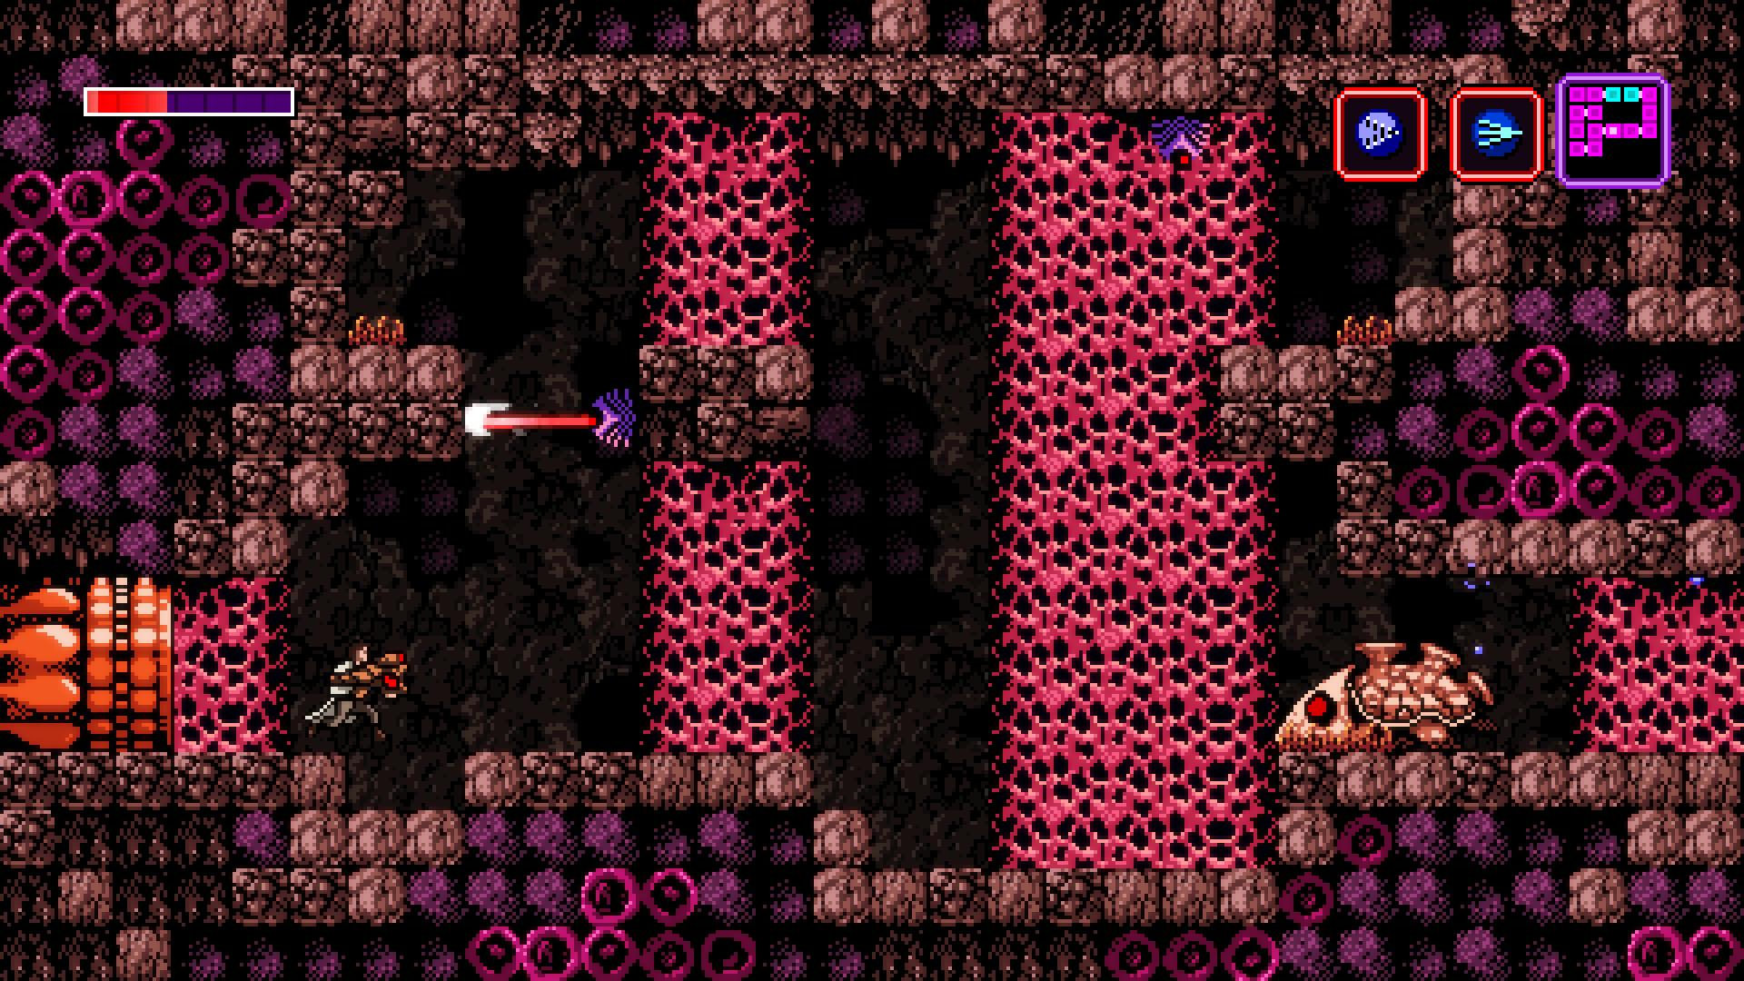
Iconoclasts (left, figure 2) features puzzles over combat
Axiom Verge (right, figure 3) focuses on retro style and combat

Slide 5
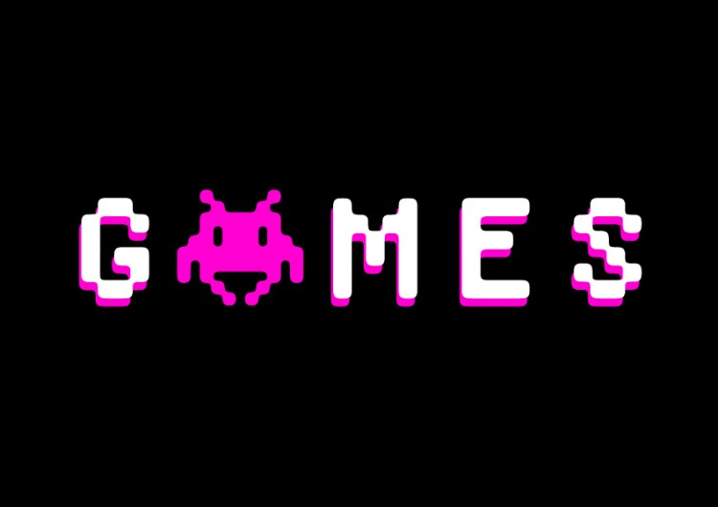
Inspiration
All of us are doing the same Bachelor’s Degree
Three of us are Interactive Media Majors
Shared interest in video games
Figure 4

Slide 6

Requirements
Original world
Original storyline
Original music, art and assets.
Create video content(opening scene)
Create engaging game for people to play
Improve our skills
Figure 5

Slide 7

Ethics
Diversity and Discrimination
Special needs consideration
Copyright issues
Software License
Figure 6

Slide 8
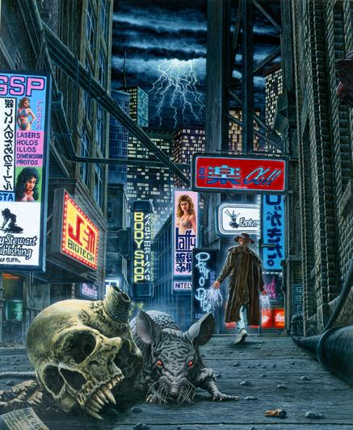
Our project
Cyberpunk and Neo-noir setting
Set in a floating metropolis
Harsh conditions for those on the ground
Sneak your way into the city to find
hoarded technology to help out the society left on the ground
Figure 7
Notes:
Toby

Slide 9
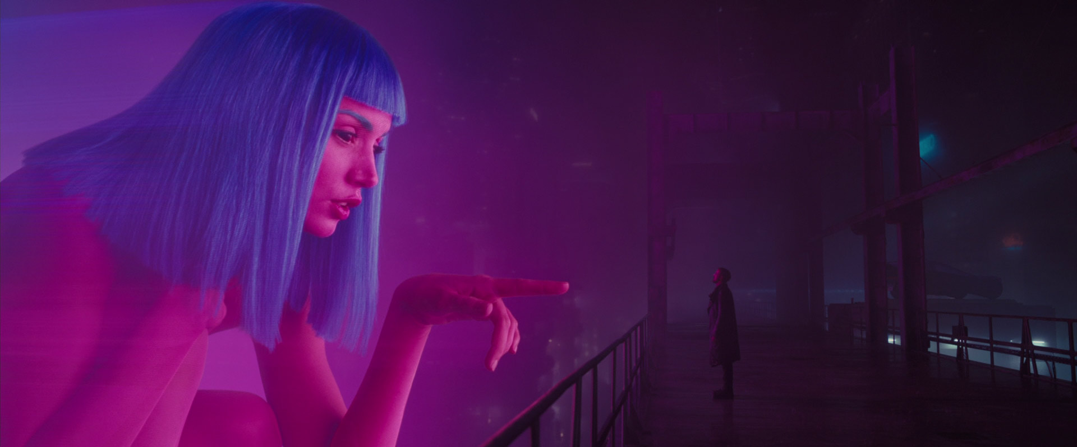
Figure 8

Slide 10
Features
Creative Boss Fights (Non-Linear fighting style)
Hacking minigames (Puzzles)
Hidden areas (Bonus levels)
Gameplay aspects (Unique gameplay)

Slide 11
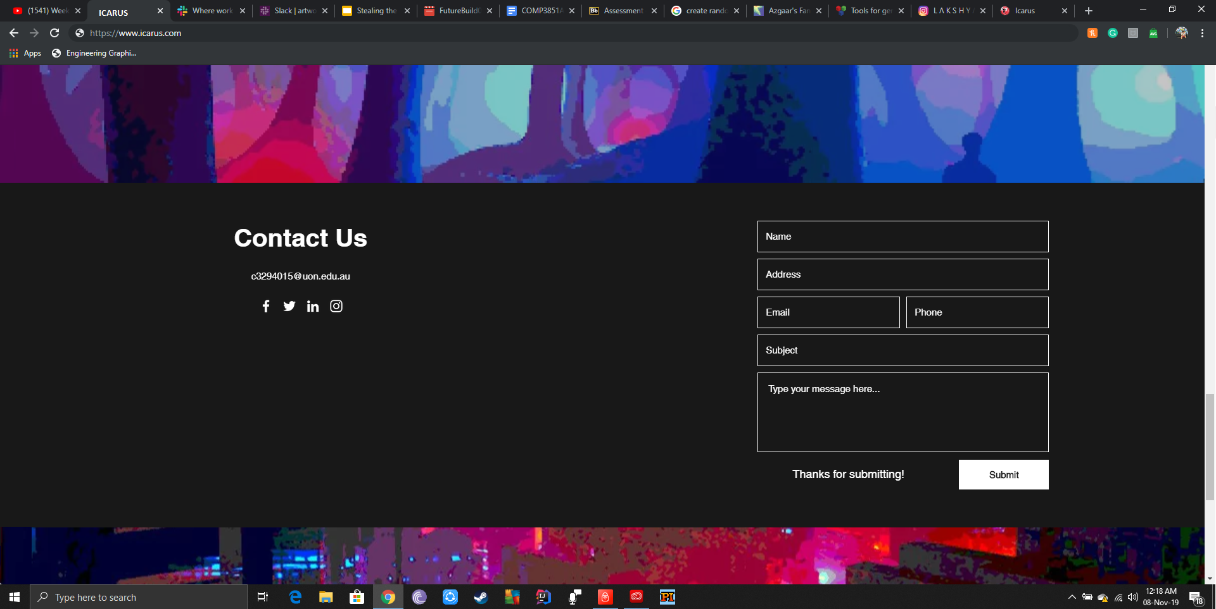


Marketing
Social media Marketing
Instagram
Facebook
Website

Slide 12

Marketing
Website
Primary platform to access content
Availability of product
Community engagement

Slide 13
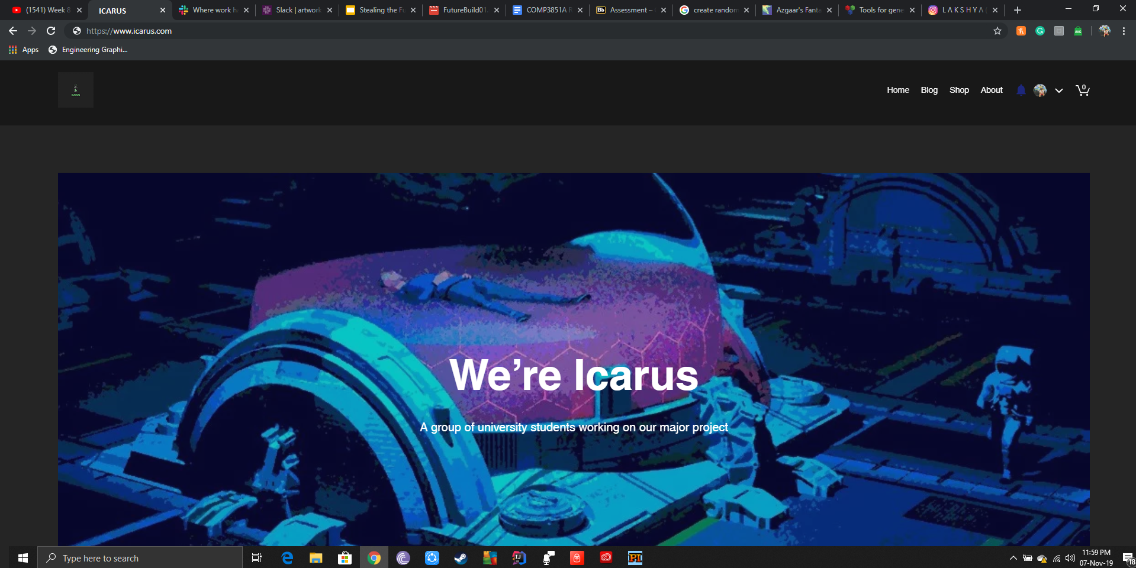
Marketing
Primary platform to access content

Slide 14
Marketing
Community engagement

Slide 15

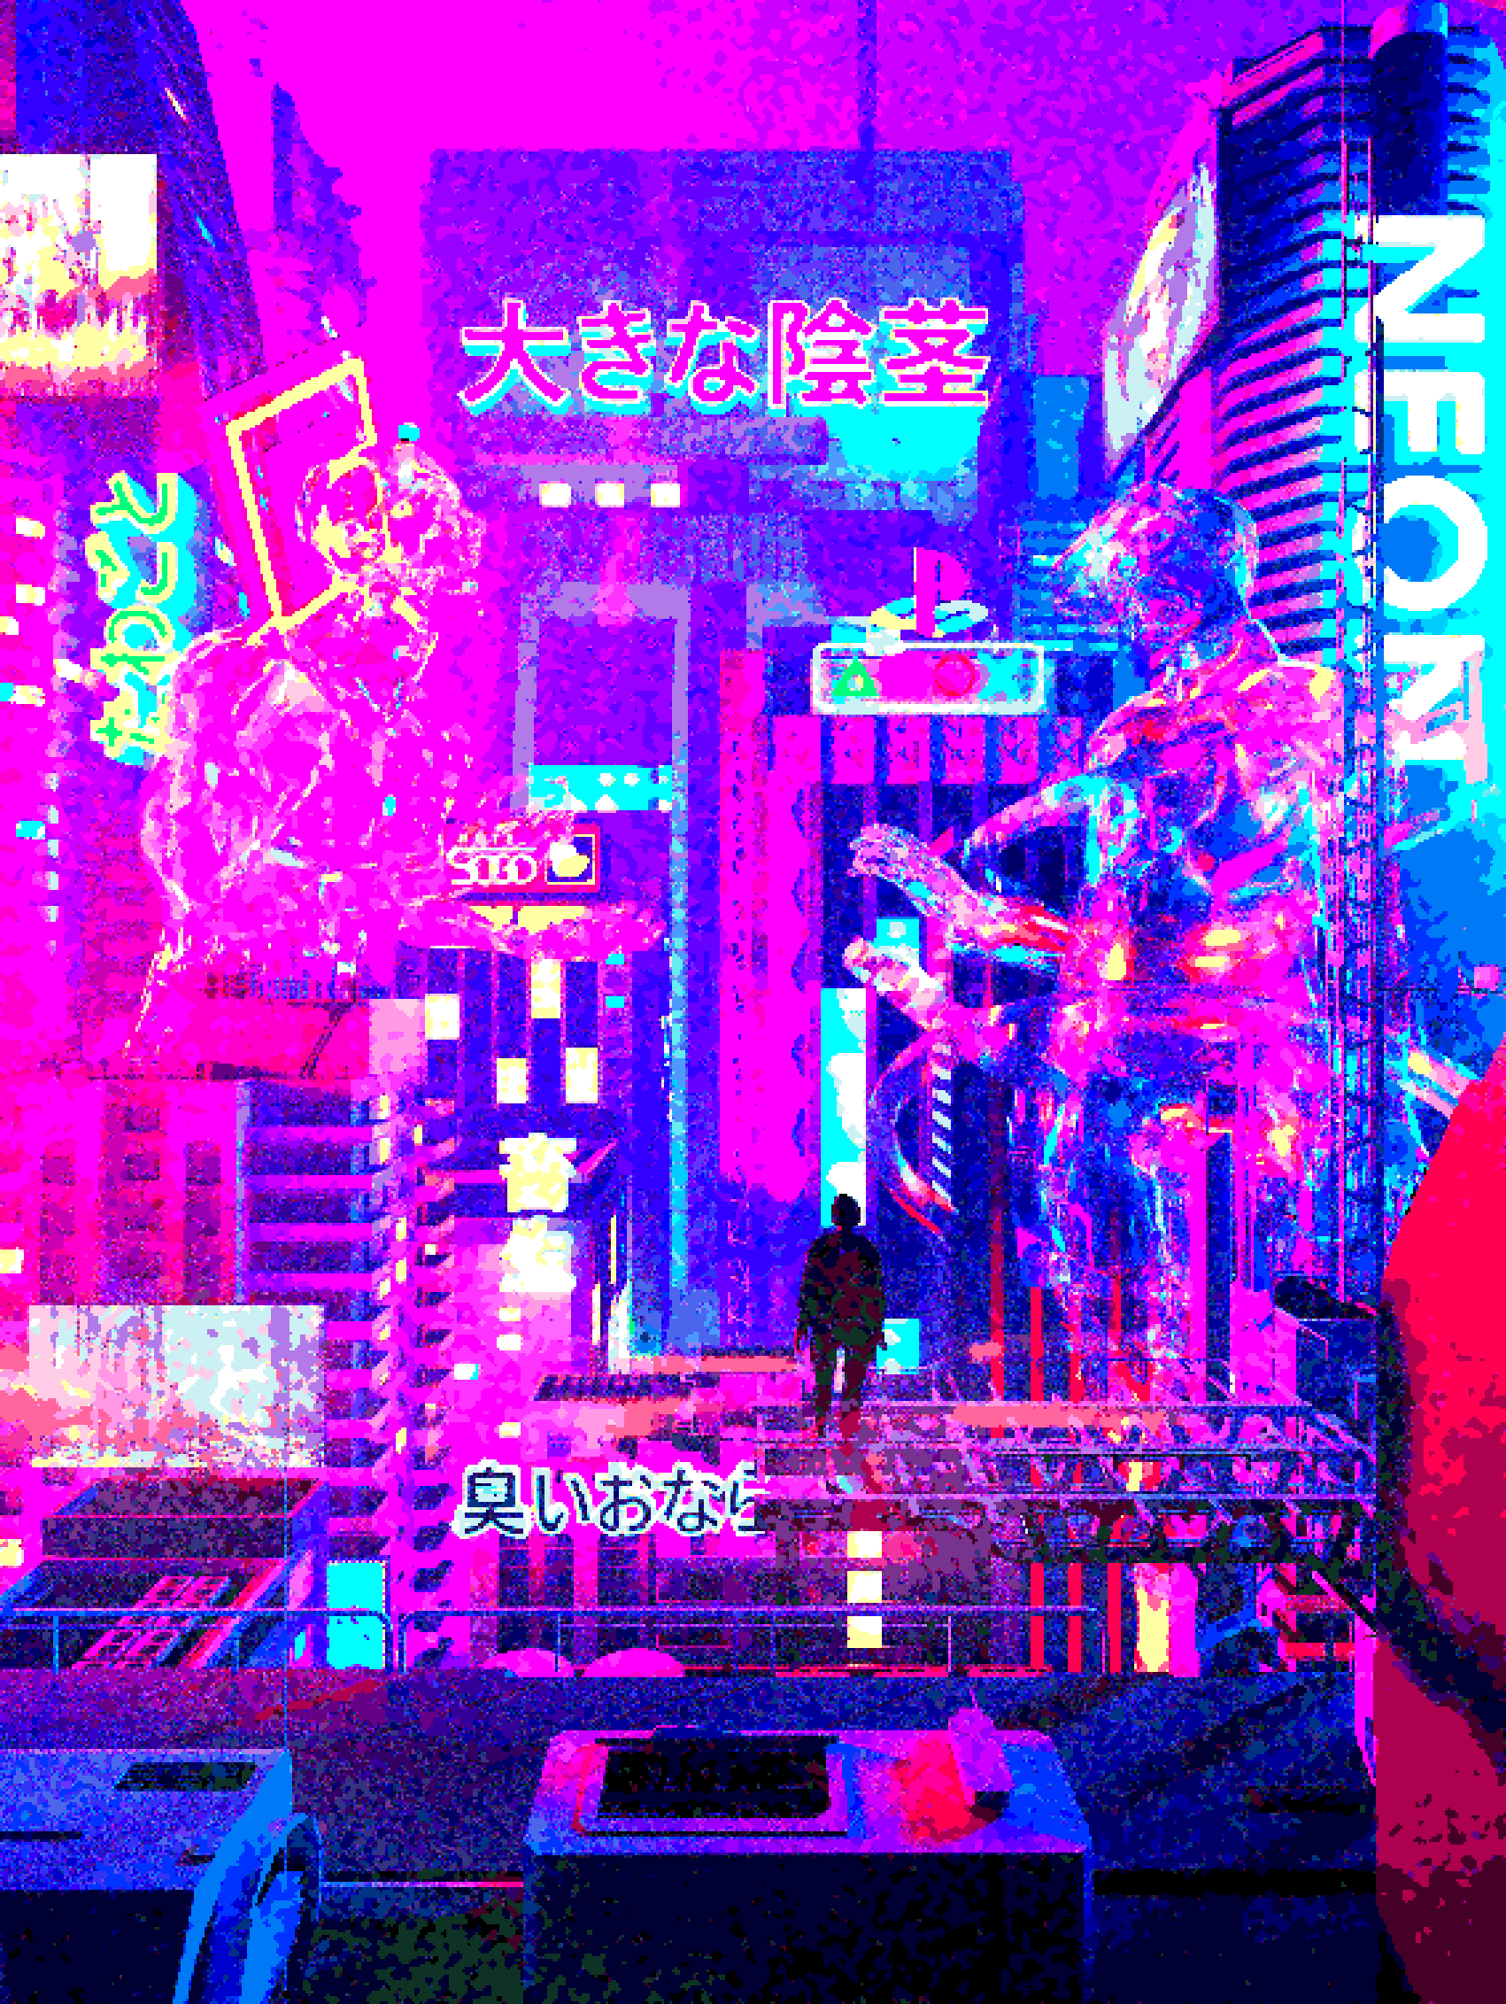
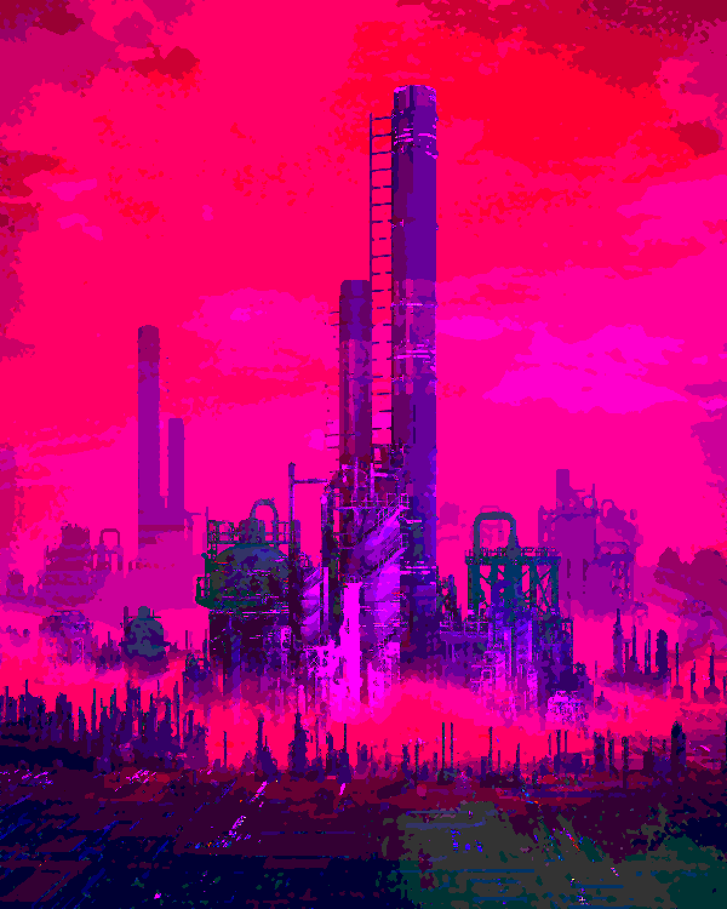
Art
Theme of concept art
Inspiration for concept art
Softwares used (Adobe CC)

Slide 16
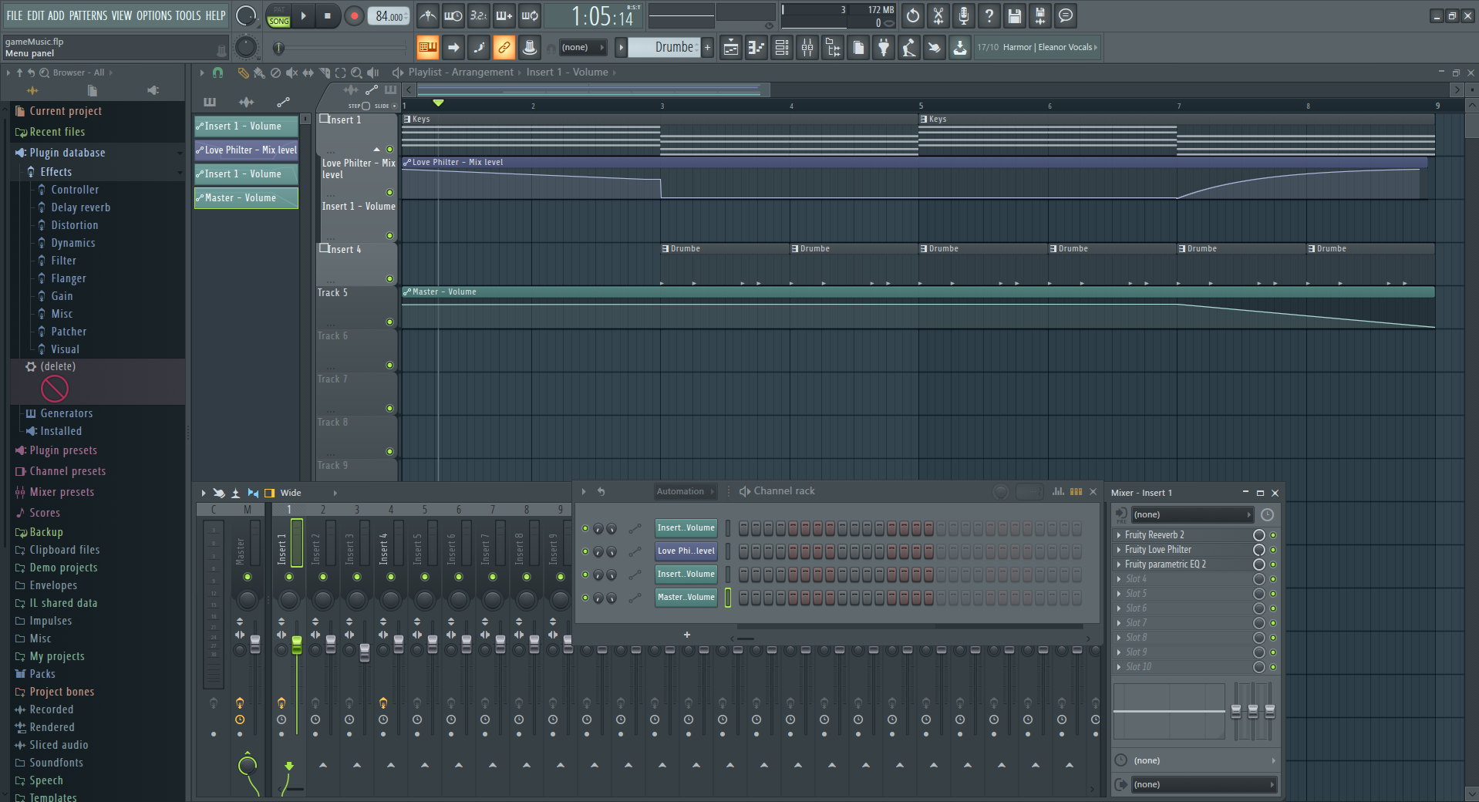
Sound
Notes:
Toby

Slide 17

Demonstration

Slide 18

Challenges and limitations
Scope of time and work
Learning new software and skills
Managing time
Creating art

Slide 19

Future plans
Implement the first “Phase” of the game
Set up marketing aspect
Create more sound and art
Finish demo to get beta testers

Slide 20
Conclusion + Questions
Stealing the Future;
Student 2D Metroidvania Game
Unique engaging story/world experience
Art and Music created by team
Planned marketing scheme
Has potential but will require lots of self learning
Questions?

Slide 21
References
Figure 1. Team Cherry (2017, February 25) Hollow Knight [Video Game]. Retrieved from: https://store.steampowered.com/app/367520/Hollow_Knight/
Figure 2. Joakim Sandberg (2018, January 23) Iconoclasts [Video Game]. Retrieved from: https://store.steampowered.com/app/393520/Iconoclasts/
Figure 3. Thomas Happ Games LLC (2015, May 15) Axiom Verge [Video Game]. Retrieved from: https://store.steampowered.com/app/332200/Axiom_Verge/
Figure 7. Catalyst Game Labs. Shadowrun [Tabletop Game]. Retrieved from: https://www.shadowruntabletop.com/site-art/environments/
Figure 8. Villeneuve, D. (Directory) and Deakins, R.(Cinematographer). (2017, October 5) Blade Runner 2049 [Motion Picture]. Retrieved from : https://screenmusings.org/movie/blu-ray/Blade-Runner-2049/

